Slide 1

Age Calculator
Project No 1

Slide 2
Submitted By:
Shakir Hussain Malik
Machine learning with python
Summer internship-July-Aug 2022

Slide 3
Introduction
Calculate the age of a person, place or thing. The age calculator calculates age given a date of birth in years, months and days. You can also use this calculator to find length of time between two dates.
The age calculator finds the age time span in years months and days, months and days, and in total days only.

Slide 4
OBJECTIVE
The main objective of age calculator is to calculate the age.
The age of a person can be counted differently in different cultures. This calculator is based on the most common age system. In this system, age grows at the birthday. For example, the age of a person that has lived for 3 years and 11 months is 3 and the age will turn to 4 at his/her next birthday one month later. Most western countries use this age system.

Slide 5
In some cultures, age is expressed by counting years with or without including the current year. For example, one person who is twenty years old is the same as one person who is in the twenty-first year of his/her life. In one of the traditional Chinese age systems, people are born at age 1 and the age grows up at the Traditional Chinese New Year instead of birthday. For example, if one baby was born just one day before the Traditional Chinese New Year, 2 days later, the baby will be at age 2 even though he/she is only 2 days old.

Slide 6
In some situations, the months and days result of this age calculator may be confusing, especially when the starting date is the end of a month. For example, we all count Feb. 20 to March 20 to be one month. However, there are two ways to calculate the age from Feb. 28, 2015 to Mar. 31, 2015. If thinking Feb. 28 to Mar. 28 as one month, then the result is one month and 3 days. If thinking both Feb. 28 and Mar. 31 as the end of the month, then the result is one month. Both calculation results are reasonable. Similar situations exist for dates like Apr. 30 to May 31, May 30 to June 30, etc. The confusion comes from the uneven number of days in different months. In our calculation, we used the former method.

Slide 7
Background
Designing the Age Calculator Interface
The first step in any Tkinter project is designing of the application window. The designing includes two steps namely:
Creating a custom window
Adding Elements to the window application

Slide 8
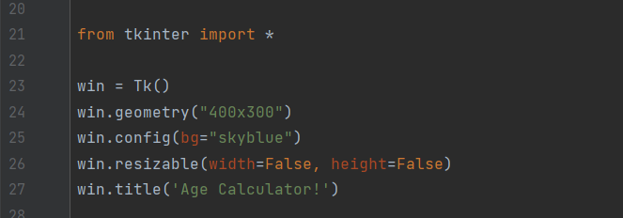
Creating a custom window
To create a empty customer window. We have to import the Tkinter module and create a window object . We add than a background colour and title of the window application.
And we also set resizable features to False to make sure the dimension remain unchanged. The code for the same is shown as below.

Slide 9
Adding all necessary elements to the window
The next step involving adding all labels, entry boxes, buttons and texts boxes in our application.
Label
we would be using multiple labels while each label would serve a different purpose. We would have labels for the introduction information. The labelling of the entry boxes ask for the date of birth from the user.
2. Entry boxes
We will be using the entry boxes for the date of birth of the user. One will be for the date, one for the month while the last one would be for the year of birth.
3. Buttons
In our application, we will be using two buttons, one for calculating age and the to exit the application.
4. Text Boxes
We will be using only one text box to display the calculated age.
The whole decision code is shown below. We will be customizing the elements according to our preference. You can change it if you like to.

Slide 10
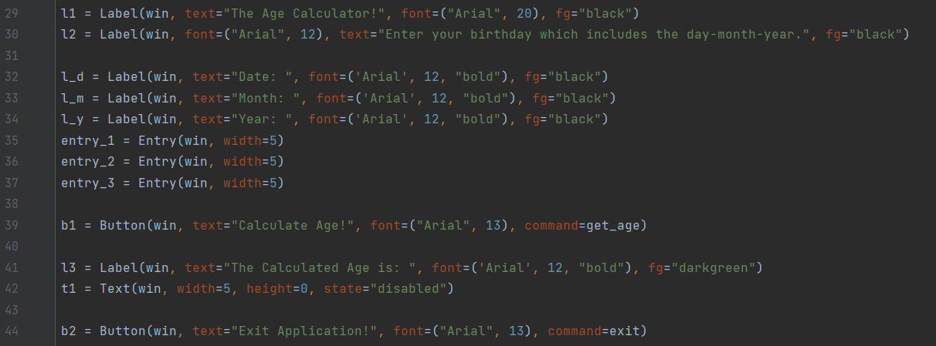

Slide 11
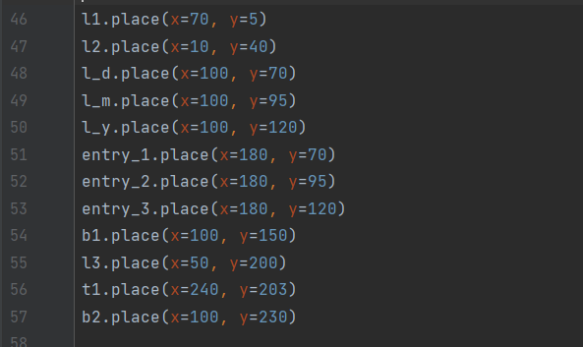
Placing the elements on the screen
To place the elements on the screen we make use of the place function which requires X and Y coordinates for the element to place the items at the correct position.
The code to place the elements is shown below:

Slide 12
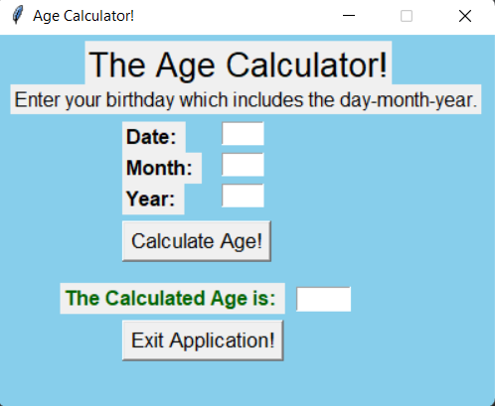
Interface for the age calculator in Tkinter
The final decision of the application looks like the window displayed below.

Slide 13
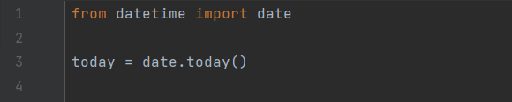
Adding functionalities to the Buttons
Calculate age Button
To calculate the age we first have to get the three inputs (day-month-year) from the three enter boxes. Now the next step involves calculating the difference between the date of birth and the current date.
To get the current date we import date function from datetime module. We also create a object which stores today’s whole date. The code for the same is shown below:
Now we create the function which calculates the age and is connected to the calculate age button. The function get the three entries and find the age(Difference between current and date of birth).

Slide 14
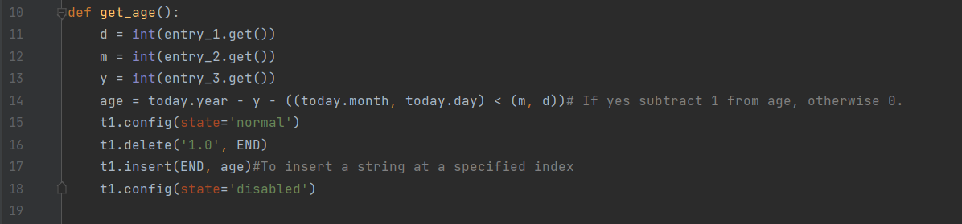
The age calculated is then inserted into the text box after clearing the previous info in the text box. The code for the same is shown below:
The highlighted line is the main statement of the code which calculates the age.

Slide 15

Exit Application Button
For the exit application we simply create a function that destroys the and after that add the command attribute to the button declaration .
The code for the exit function is shown below:

Slide 16
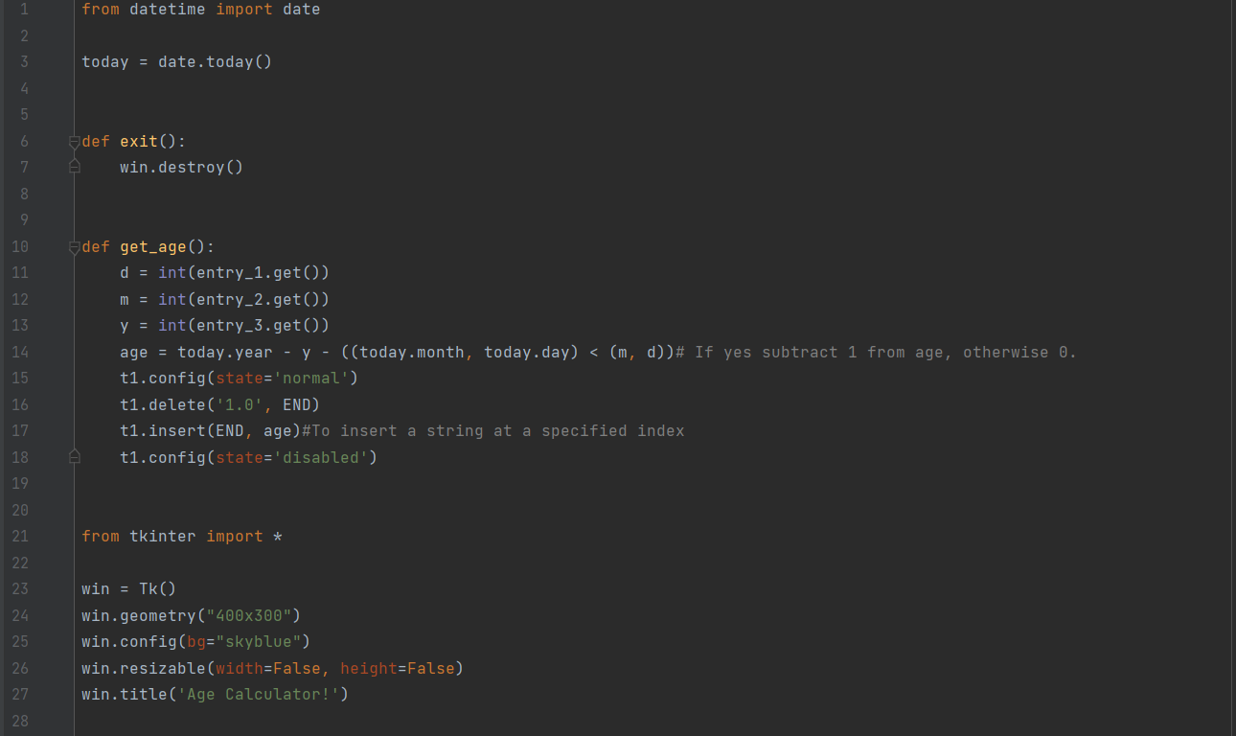
Complete code for age calculator in python
The whole code is mentioned below:

Slide 17
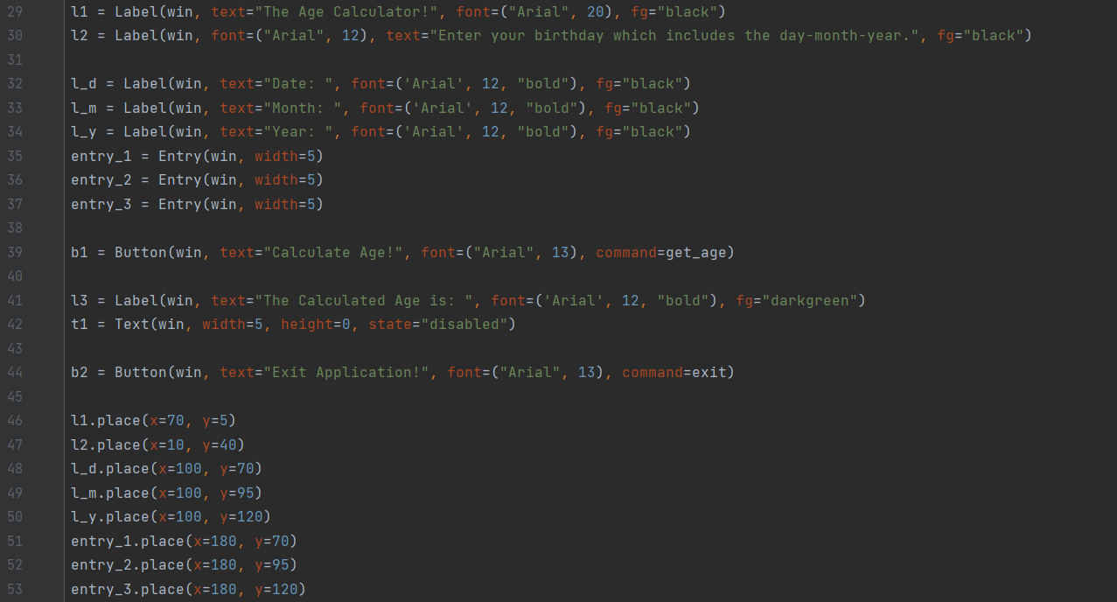

Slide 18
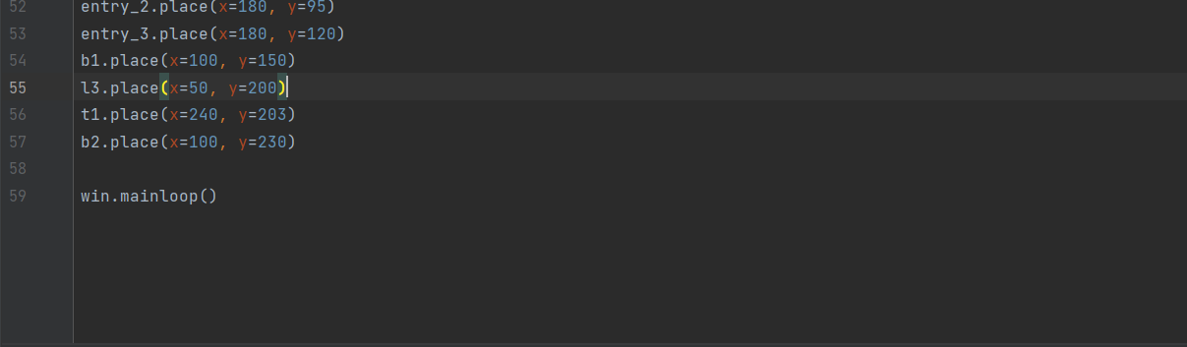

Slide 19
Hardware and Software requirements
Hardware:
1.Laptop or
2.Desktop
Software:
1.pycham

Slide 20
Future scope
In the todays world we need to fill the birth date in the various kinds of the form. But for some of the persons there birth month comes in the mid of the year or in the mid of the month and it get sometimes complicated to calculate the age at the given moment of the time. So for such case age calculator is very use full application.
Also in todays world a person has many kinds of tasks and works to do and they even forgot the age. So for that also the age calculator is used.

Slide 21
Conclusion
By this we have completely build the age calculator.
Thank you

Slide 22
References and bibliography
For the code reference:
https://www.askpython.com/python-modules/tkinter/age-calculator
For the objectives and working reference:
https://www.askpython.com/python-modules/tkinter/age-calculator

